Slide 1
AVL TREES
Inventors : Adelson-Velskii and Landis

Slide 2
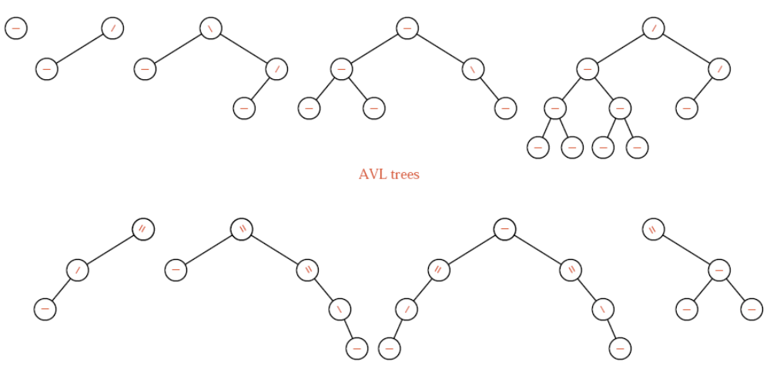
AVL TREES - I
from “Data Structures and Program Design in C++ - Robert L. Kruse”

Slide 3
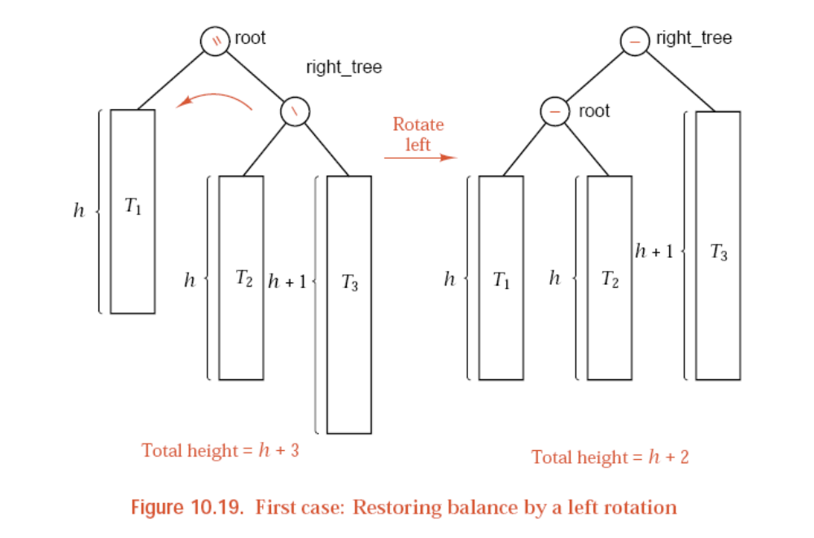
AVL TREES - II
from “Data Structures and Program Design in C++ - Robert L. Kruse”

Slide 4
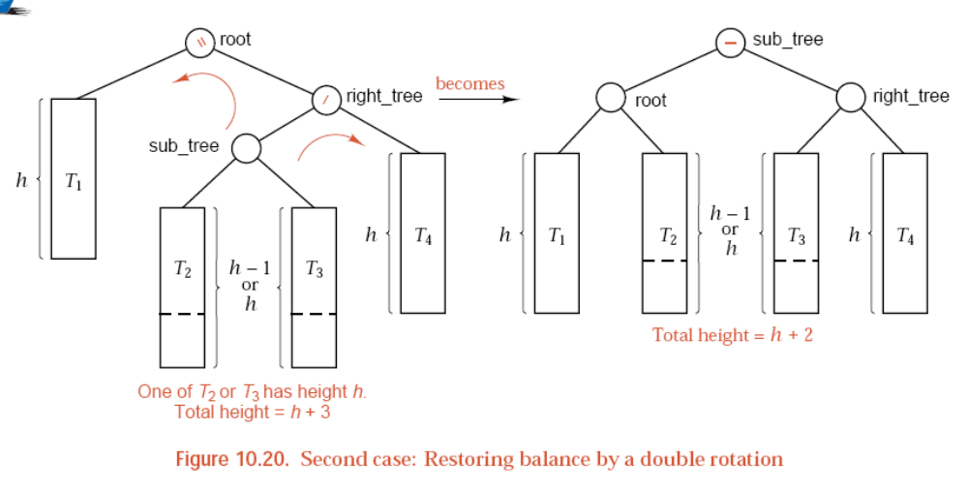
AVL TREES - III
from “Data Structures and Program Design in C++ - Robert L. Kruse”

Slide 5
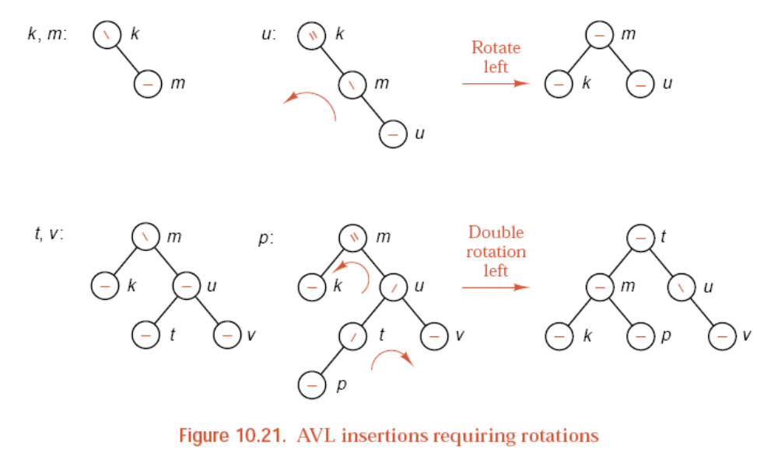
AVL TREES - IV
from “Data Structures and Program Design in C++ - Robert L. Kruse”

Slide 6
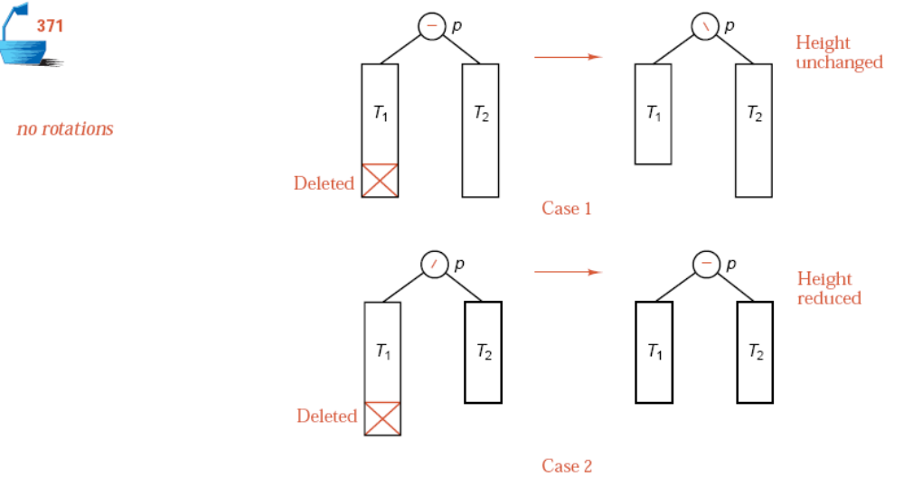
AVL TREES - V
from “Data Structures and Program Design in C++ - Robert L. Kruse”

Slide 7
